Slide 1

Introducing {workboots}
Generate prediction intervals from tidymodel workflows
Mark Rieke
2022-07-27
<link to slides>

Slide 2
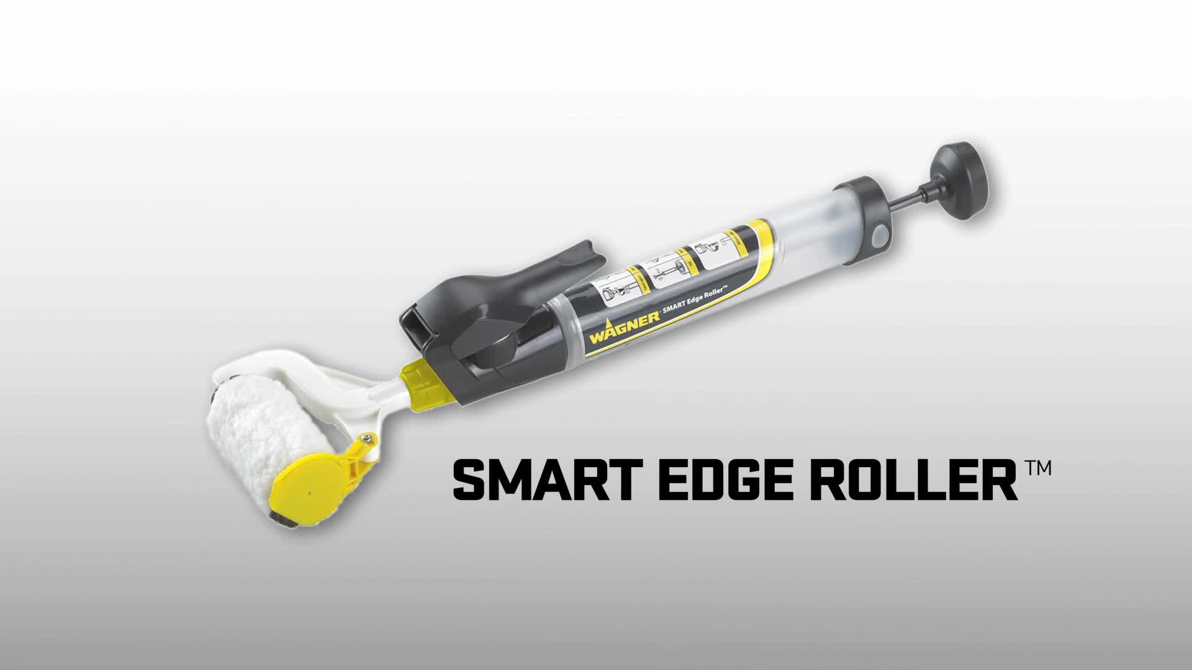

Slide 3
paint brush with bluetooth

Slide 4
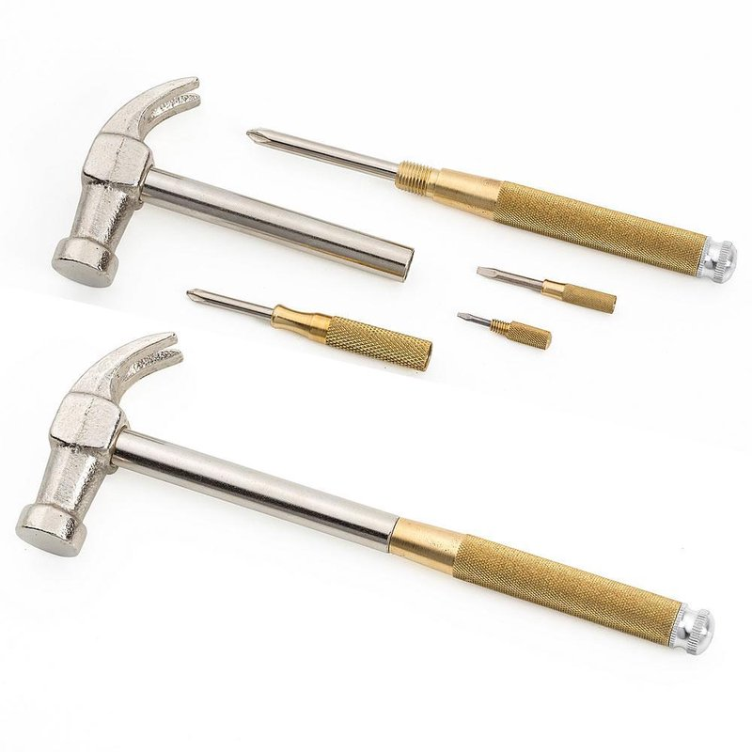

Slide 5
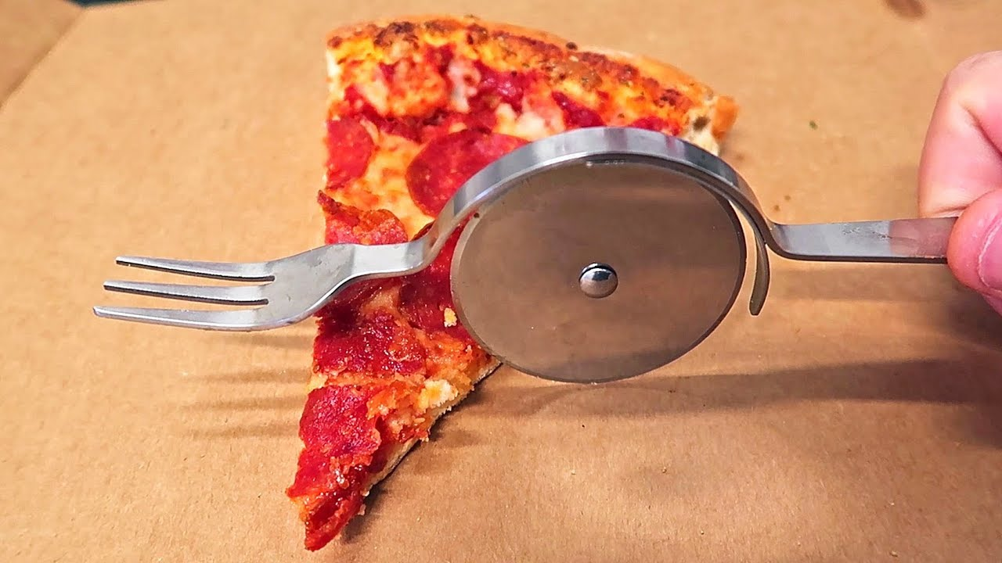

Slide 6
Kreg jig slide 1
Tool itself – specific tool, specific job

Slide 7
Kreg jig slide 2
Joining edges

Slide 8
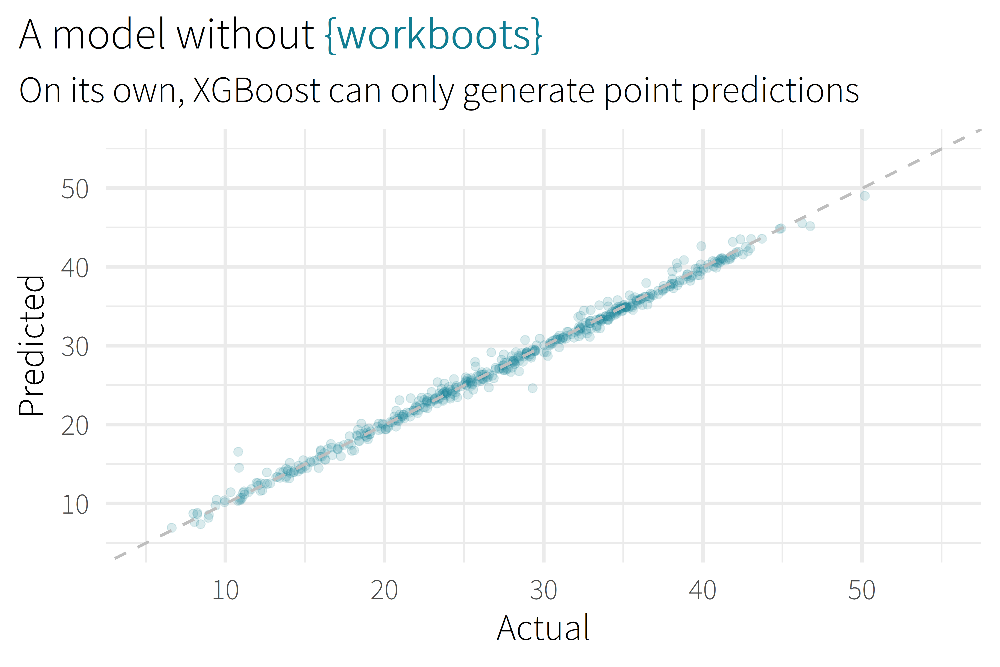

Slide 9
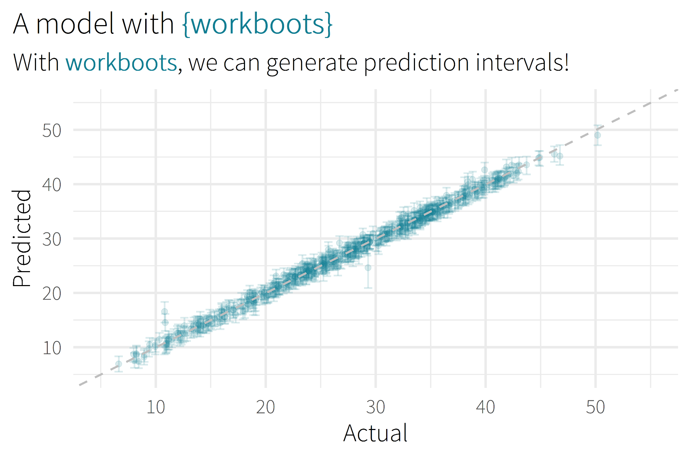

Slide 10

Motivation/Background

Slide 11
Package Overview

Slide 12
setting up a workflow
library(tidymodels)

Slide 13
setting up a workflow
library(tidymodels)
# setup our data
data(“penguins”)
penguins <- penguins %>% drop_na()

Slide 14
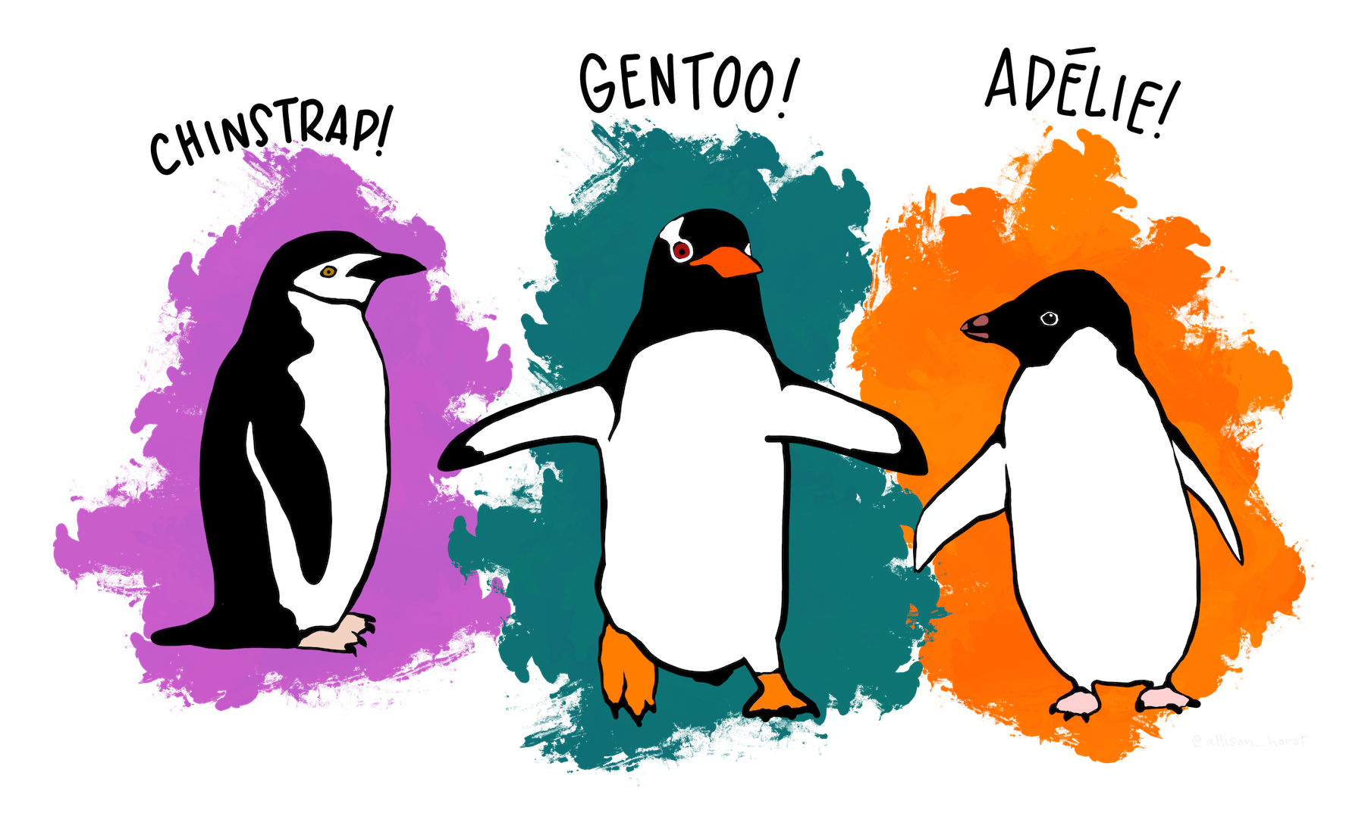
setting up a workflow
library(tidymodels)
# setup our data
data(“penguins”)
penguins <- penguins %>% drop_na()

Slide 15
setting up a workflow
library(tidymodels)
# setup our data
data(“penguins”)
penguins <- penguins %>% drop_na()
set.seed(123)
penguins_split <- initial_split(penguins)
penguins_test <- testing(penguins_split)
penguins_train <- training(penguins_split)

Slide 16
setting up a workflow
# setup a basic preprocessing recipe
penguins_rec <-
recipe(body_mass_g ~ ., data = penguins_train) %>%
step_dummy(all_nominal())

Slide 17
setting up a workflow
# setup a basic preprocessing recipe
penguins_rec <-
recipe(body_mass_g ~ ., data = penguins_train) %>%
step_dummy(all_nominal())
# put together a workflow
penguins_wf <-
workflow() %>%
add_recipe(penguins_rec) %>%
add_model(boost_tree(“regression”))

Slide 18

workbootin’
library(workboots)
# generate a bootstrap prediction interval
set.seed(345)
penguins_preds <-
penguins_wf %>%
predict_boots(
n = 2000,
training_data = penguins_train,
new_data = penguins_test,
interval = “prediction”
)

Slide 19
workbootin’
penguins_preds
#> # A tibble: 84 x 5
#> rowid .preds
#> <int> <list>
#> 1 1 <tibble [2,000 x 2]>
#> 2 2 <tibble [2,000 x 2]>
#> 3 3 <tibble [2,000 x 2]>
#> 4 4 <tibble [2,000 x 2]>
#> 5 5 <tibble [2,000 x 2]>
#> # ... With 79 more rows

Slide 20
workbootin’
penguins_preds %>%
summarise_predictions() %>% select(-.preds)
#> # A tibble: 84 x 5
#> rowid .pred .pred_lower .pred_upper
#> <int> <dbl> <dbl> <dbl>
#> 1 1 3465. 2913. 3994.
#> 2 2 3535. 2982. 4100.
#> 3 3 3604. 3050. 4187.
#> 4 4 4157. 3477. 4764.
#> 5 5 3868. 3305. 4372.
#> # ... With 79 more rows

Slide 21
workbootin’
library(workboots)
# generate a bootstrap prediction interval
set.seed(345)
penguins_preds <-
penguins_wf %>%
predict_boots(
n = 2000,
training_data = penguins_train,
new_data = penguins_test,
interval = “prediction”
)

Slide 22
workbootin’
library(workboots)
# generate a bootstrap prediction interval
set.seed(345)
penguins_preds <-
penguins_wf %>%
predict_boots(
n = 2000,
training_data = penguins_train,
new_data = penguins_test,
interval = “prediction”
)

Slide 23
workbootin’
library(workboots)
# generate a bootstrap prediction interval
set.seed(345)
penguins_preds <-
penguins_wf %>%
predict_boots(
n = 2000,
training_data = penguins_train,
new_data = penguins_test,
interval = “confidence”
)

Slide 24
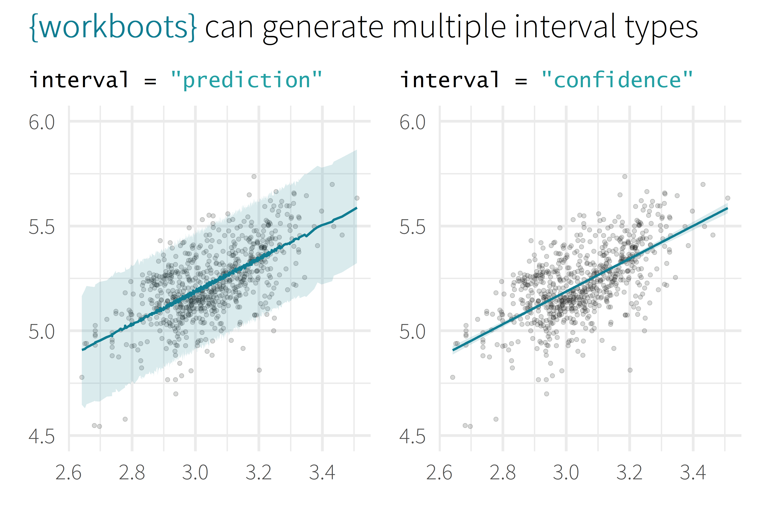

Slide 25
overview
Selling Point
About me
Motivation / Background
Package overview
Cost of doing business
(1 min)
(2 min)
(5 min)
(5 min)
(5 min)

Slide 26








about me
BSME, University of Tulsa
Sr. CX Analyst, MHHS
@markjrieke

Slide 27
“I use R and tidymodels to provide actionable insight from patient survey data.”

Slide 28
plot/plot/plot

Slide 29
plot/plot/plot
context/context/context

Slide 30

5.0 (19)
4.6 (2,280)

Slide 31
What is the range of possible outcomes?
How important is each variable in the model?

Slide 32

lm()
me
XGBoost

Slide 33
Prediction Intervals

Slide 34
Prediction Intervals
Powerful Models

Slide 35
Prediction Intervals
{workboots}
Powerful Models

Slide 36
Prediction Intervals
{workboots}
Powerful Models
via bootstrap resampling

